Slide 1
Te
National CIGFARO mSCOA WORKSHOP 2020
Proposed Version 6.5 Chart Changes
Presented by National Treasury – Kgomotso Baloyi – 12 November 2020

Slide 2
Te
ITEM SEGMENT
REVENUE

Slide 3
Item Revenue
9989: The number of City Improvement Districts grow from year to year. In the next version of the GRID, may we ask that National Treasury discontinue all of the GUID's in the GRID (and their "friends" in the other segments and replace it by 1 GUID which can be described as "City of Cape Town CID's". This will simplify the roll-out of GUID's for a new budget cycle. Keep in mind that in our own reporting we can still report the breakdown per individual CID.
Solution: Retire all CIDs for Cape Town and replace with the item City Improvement Districts in IR, IL and Fund segments

Slide 4
GRAP 11 – Construction Revenue
10005 - According to GRAP 11, construction revenue should be classified as Financial Performance as a separate line item and is not classified as Exchange or Non-Exchange transaction. V6.4 does not make provision for such a revenue. Could you please incorporate in next version V6.5
Solution
The mSCOA Chart under Item Revenue: Exchange Revenue: Sale of Goods and Rendering of Services
Add a line for “Construction contract revenue” Definition : “ Construction revenue as a result of a Construction contract per GRAP 11.”
Contract Revenue for Non Exchange revenue are covered under Transfers and Subsidies

Slide 5
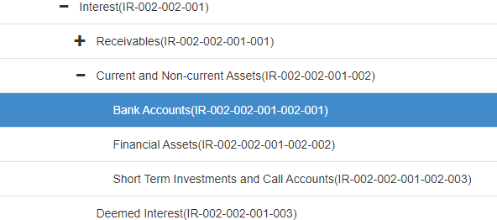
Item Revenue
8954: Interest is received by the municipality on amounts paid and held by attorneys
8955: The municipality/municipal entity pays deposits to Eskom of which the municipality earns interest on these deposits. Where on the item revenue chart should the interest received be recorded? Please add Interest received on deposit held by suppliers to the item review chart
Solution: Utilise Financial Assets: Expand definition to include that Financial Assets refers to interest received from any third party(GRAP)

Slide 6
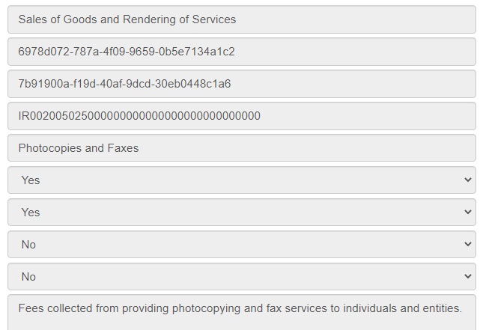
Item Revenue
10015 A request to add a Revenue Item GUID under Sale of Goods & Rendering of Services for Telephone services. We bill private / government departments for the usage of telephone services at our Thusong Centre. There is no relevant Revenue Item GUID for this
Solution: Item Revenue : Exchange revenue: Sales of Goods and Services: Photocopies and Faxes
Propose to change the name to “Photo copies, Faxes and Telephone charges” and to include “Telephone charges” in the definition.

Slide 7
Te
ITEM SEGMENT
EXPENDITURE

Slide 8
Item Expenditure
8932: The Chart does not allow you to split the "Cellphone and Telephone Allowance" between the Allowance and the re-imbursement. There must be a line item where the expenditure is re-imbursive. An employee here bought airtime because a building burnt down and he (and others) could not use the landline. He bought for himself and others. We cannot re-imburse him from the allowance and maybe we need a line item for that
Solution: Amend the description: to Cellular Expenditure and definition to include reimbursements of cellular expenditure

Slide 9
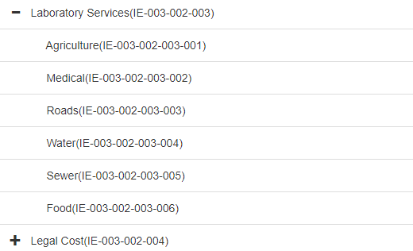
Item Expenditure
9985: On behalf of City power: Please add 'Oil Testing' under Laboratory services under the item expenditure - consultants and professional fees.
Logged by City of Joburg : March 2020
Solution: To add a line called “Electrical” –Definition to include “Oil Testing of Electrical equipment”

Slide 10
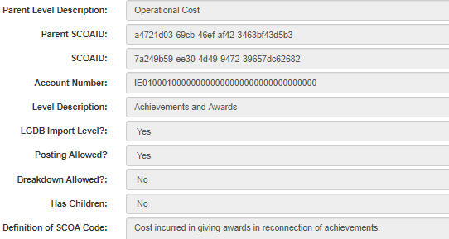
Item Expenditure
8918: Can the definition of GUID 6834793e-9435-47ab-9f83-10bdb8df588e: Rewards Incentive be expanded to include Reward Incentives to Individuals and Organisations. Council has approved the "Taxi Incentive Programme" whereby we reward Taxi Owners who register for the programme incentives for good driving.
Solution: Correct the word reconnection to “recognition” .Refer the logger to use this line item.

Slide 11
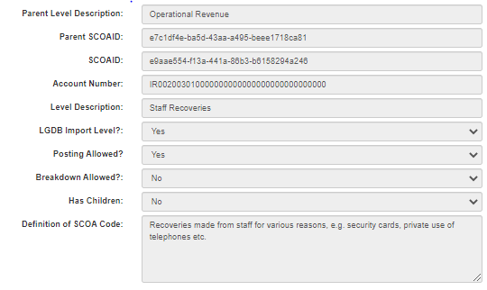
Item Expenditure
8919: NMBM would like to request a new additional item on Revenue: Exchange: Operational Revenue: Councillors Recoveries. The definition will be recoveries made from councillors for various reasons, e.g. private use of telephone, etc.
Solution: Staff Recoveries description and definition be expanded to include Councillors: Councillor and staff recoveries

Slide 12
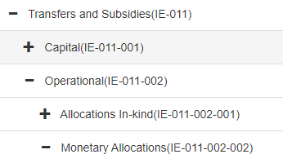
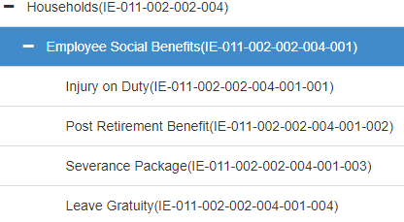
Item Expenditure
FAQ 8963: Which Item: Expenditure can be utilized for an Arbitration Settlement pay out? The chart does not cater for employees that have been dismissed and have now reached a settlement pay out in an arbitration hearing.
Solution: In the case of an arbitration award for a person leaving the employ of the entity after a Bargaining Council decision a separate line under Item :Expenditure: Transfers and Subsidies : Operational: Monetary allocations: House holds : Employee social benefits :Arbitration awards should be added

Slide 13
Te
ITEM SEGMENT
Assets

Slide 14
Item Assets
9998: The definitions in ITEM ASSETS: PPE for all categories for Transfers received and Transfers Made does not make sense. We request that it be changed
Solution: Change Definitions of Transfers Made and Transfers Received on the whole of PPE classifications.

Slide 15
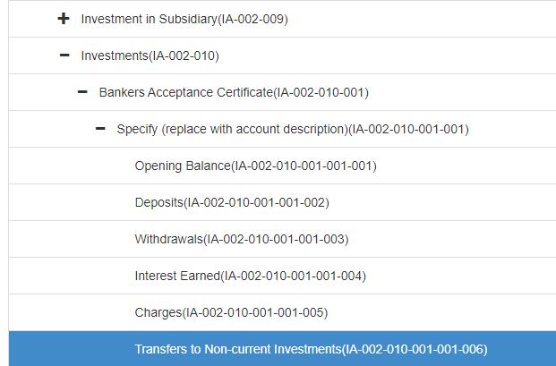
Item Assets
8820: Movement account used in Non-current Investment to be renamed to "Current Assets" and not "Non-current Assets.
Solution: Retire “Transfer to Non-Current Investments”

Slide 16
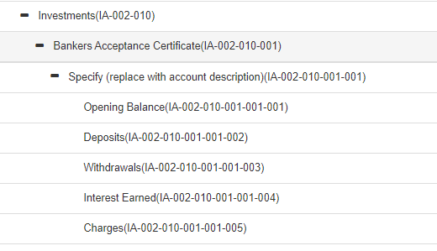
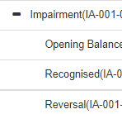
Item Assets
8930(dup) & 8931: The following item accounts needs to be added to the item segment as they are included in the illustrative AFS: Carrying value of investments: Provision for impairment Reclassifications
Solution: The carrying balance in the AFS specimen is the opening balance in the mSCOA chart. No change to be made.
Add: Provision for impairment on investments, with breakdown as per list

Slide 17
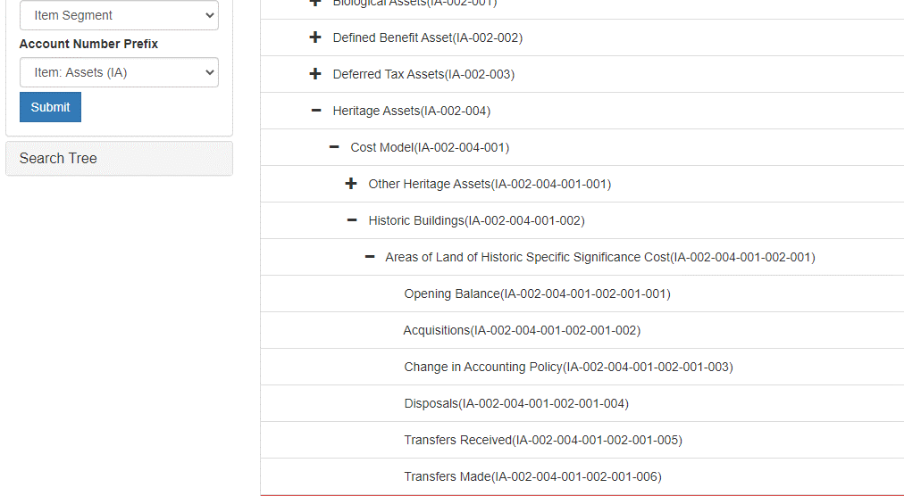
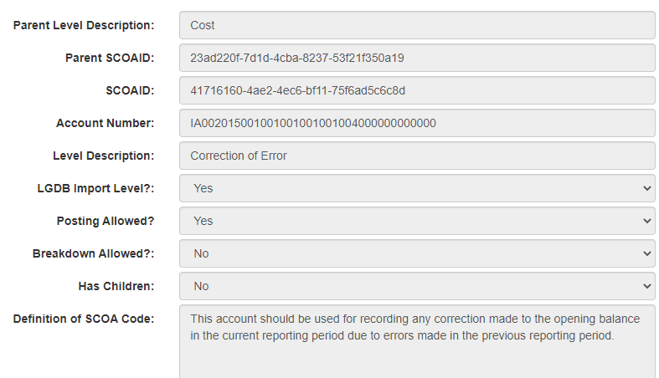
Item Assets: Heritage Assets
8950: Please include the following for a FAQ for V6.4 for MSCOA:
Heritage assets does not have an option for Correction of Error on V6.3, like under Property, Plant and Equipment.
Solution: Include Correction of Prior Period Errors in all Heritage assets classifications exactly like in PPE Add to definition “as per GRAP 3”

Slide 18
Item Assets – Land inventory
8951 "Please add the following FAQ for V6.4:There is no ""Prior Period Corrections and Adjustments"" option under any Inventory lines, for example Land. Please include ""Prior Period Corrections and Adjustments"" option for V6.4 under Inventory and other Assets and Liabilities as well, which does not have that option to correct the AFS for prior period errors/restatements.“
Solution: “ Correction of Prior period errors”
Definition: Outline Prior period errors in the definition and add “as per GRAP 3”

Slide 19
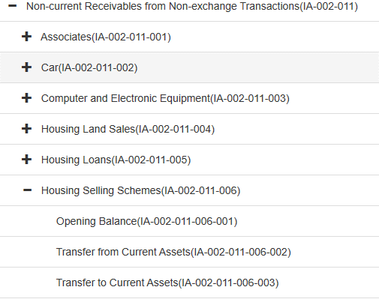
Item Assets
10007 - No impairment votes available for Non Current Receivable from Non-Exchange Transactions: Housing Selling Scheme
9996: Non-Current Receivables - No separate string for impairment and write off. Municipalities are required to determine if there are any impairment and recovery of non-current assets. There is no accommodation for this on the current version of the 6.4 chart under item assets.
NB: Guidance on forbidden activities as per S164 of the MFMA to be provided in the budget circular
Solution: Add Impairment both Current and non-current receivables for Housing selling schemes, Operating leases, Associates, Subsidiaries and Joint ventures.

Slide 20
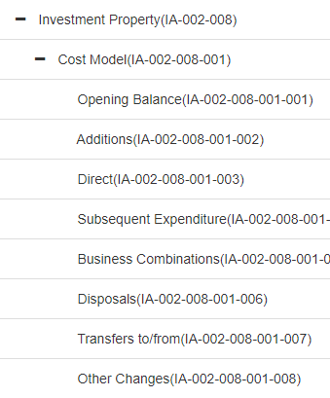
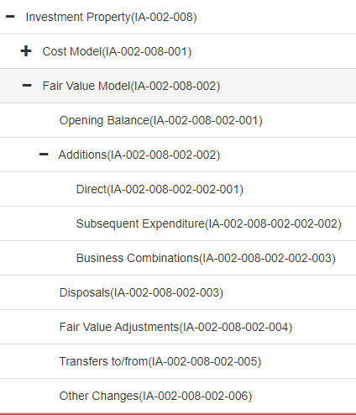
Item Assets
9971 Please align the classification structure for Investment Properties: Cost model and Fair value adjustments in such a way that it promotes roll-up reporting in the long codes
Sub category
Solution: Create a sub reporting level for Additions (Direct, Subsequent and Business combinations) in Investment Property Cost model similar to Investment Property Fair Value Model

Slide 21
Te
ITEM SEGMENT
liabilities

Slide 22
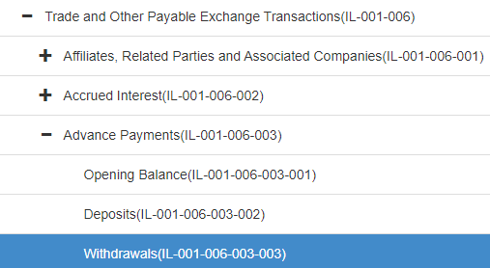
Item Liabilities
10004 GRAP 11 : Construction contracts – In line with newly effective GRAP standard, Mossel Bay has received an opinion from AFS consultants on how to treat Unspent portion of Human Settlements Grant, if the contract is treated in AFS as a construction contract..
GRAP 11 par 58 states the following:
An entity shall present:
(b) the gross amount due to customers for contract work as a liability.
Solution: For Construction work that is a commitment due to customers, funded from Exchange revenue the users should utilize Trade and other Payable Exchange Transactions: Advance payments
Add “Transfer to Revenue” as these advance payments will not be refunded but will be recognised by delivery of the construction commitment.

Slide 23
Item Liabilities
Expanding Trade and other Payables and Accruals to cater for detailed information to populate the cashflow for Inventory purchased and payment of Services delivered.
Payables and Accruals: Contractors
This account is the accrual for Liabilities for payments of Contractors
Payables and Accruals: Inventory
This account is the Accrual for Liabilities for Inventory purchased
Payables and Accruals: General
This account is the Accrual for Liabilities for Payable and Accruals for other Expenses
Solution: Add 2 items to Payables and Accruals “ Inventory” and “Contractors” with movement accounting
- Opening
- Deposits
- Withdrawals
Rename Payables and Accruals to Payables and Accruals : General

Slide 24
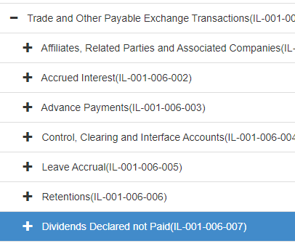
Item Liabilities
Change Description of “Dividends declared not paid” to “Dividends declared” the line item is a Liability that already means it is and accrual that is payable.
Solution: Change name of Dividends declared not Paid to “Dividends declared”

Slide 25
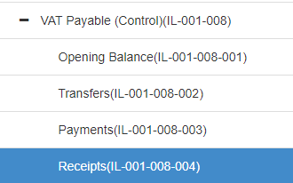
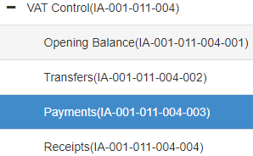
Item Liabilities
Vat Control – Changes to the chart
Vat Payable (Control) (IL-001-008)– retire Receipts
Vat Control (IA-001-011-004) – retire payments
Solution: Change description VAT Control in IA to “VAT Control (Receivable)” and
Change description VAT Payable (Control) in IL to “VAT Control (Payable)”
Retire VAT Control IL- Receipts
Retire Vat Control IA- Payments

Slide 26
Te
ITEM SEGMENT
GAINS & Losses

Slide 27
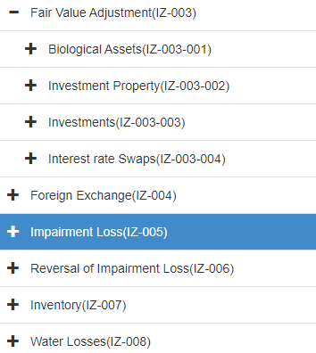
Item Gains & Losses
10018 Remove Actuarial Gains/ losses from Expenditure chart and add to Gains and Losses chart
In Gains and losses under Fair value Adjustments
Add Actuarial assessments
Medical Aid (gains & loss)
Pension funds (gains & loss)
Long Service (gains & loss)
Leave gratuity (gains & loss)
Retire Actuarial gains/ losses from Item Expenditure
Solution: Move Actuarial gains and losses to Item Gains and losses Retire actuarial gains and losses in Item Expenditure: Employee benefits

Slide 28
Te
FUnd SEGMENT

Slide 29
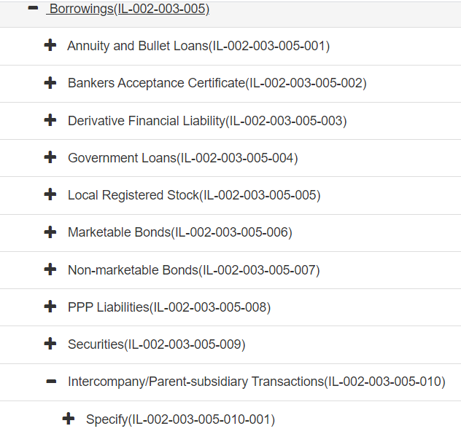
Fund segment
8899: Parent-subsidiary transactions for borrowings is included on the current mSCOA Item Charts: Liabilities: Non-current Liabilities: Financial Liabilities: Borrowings: Intercompany /Parent-subsidiary Transactions: Specify: Opening Balance. There are various GUIDS. For the fund segment this has been excluded: Please add this to the fund chart.
Solution: Add a Funding source: Borrowing: Parent Municipality in the Fund Segment

Slide 30
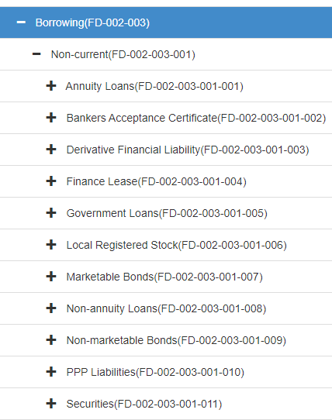
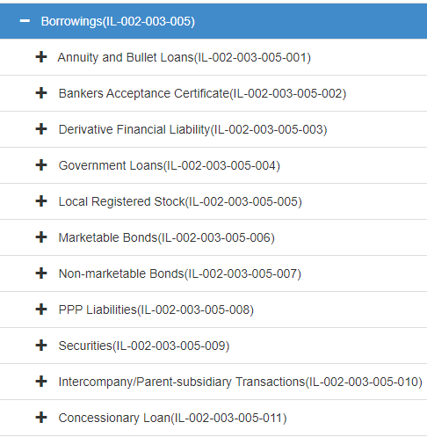
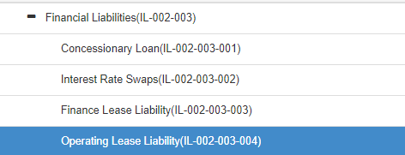
Fund Segment
9969 and 9970: Fund Capital Borrowing mismatch to Non-current Liabilities Borrowings.
Solution: Item Liabilities: Retire – IL002003001Concesionary loans and Interest rate swaps, Move Finance Lease to Borrowings (Provide movement accounting), Add Non-Annuity loans(with movement accounting)
In Fund: Borrowings: Non Current Annuity loans change to Annuity and Bullet Loans, add Concessionary loans and Parent Municipality

Slide 31
Fund Segment
Interest earned definitions for Current and Non-Current Assets and Receivables must be swoped as it is currently not referring to the correct meaning.
Solution: Change the definitions of this 2 funding sources as it is wrongly allocated

Slide 32
THANK YOU
For additional information on national and provincial budgets, please visit our new budget data portal: https://vulekamali.gov.za
For information on local government finances, please visit: https://municipalmoney.gov.za

